Slide 1



Data Preprocessing
INTRODUCTION TO MACHINE LEARNING
- Ashwina Rakish

Slide 2
Few Key Terms
Records: Individual instances or observations in a dataset
Features: Also known as variables or attributes, serving as the columns in a dataset.
Categorical features: Variables that represent qualitative attributes.
Numerical features: Variables that represent quantitative attributes with measurable values.
Outliers: Data points that significantly deviate from the majority of observations in a dataset.
Labels: Represent the values which can be taken up by the target variable or output.

Slide 3


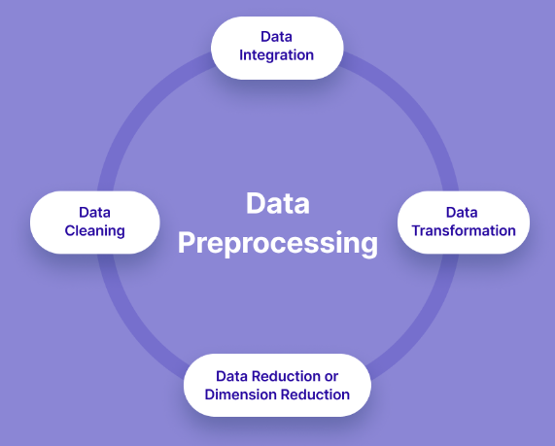


Data Preprocessing
1. Data Cleaning
3. Data Integration
Combining Data from multiple sources
Correcting errors
Handling Missing Values
Removing outliers if required
2. Data Transformation
4. Data Reduction
Scaling and Normalization
Encoding
Dimensionality Reduction
Attribute Subset Selection

Slide 4
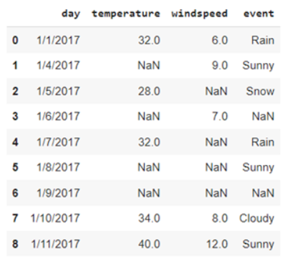
Data Cleaning
Missing Values:
- Delete record containing missing values
- Imputing missing value with
- mean
- median
- mode
- Forward and Backward Fill
- Interpolation
- Predict using a model

Slide 5
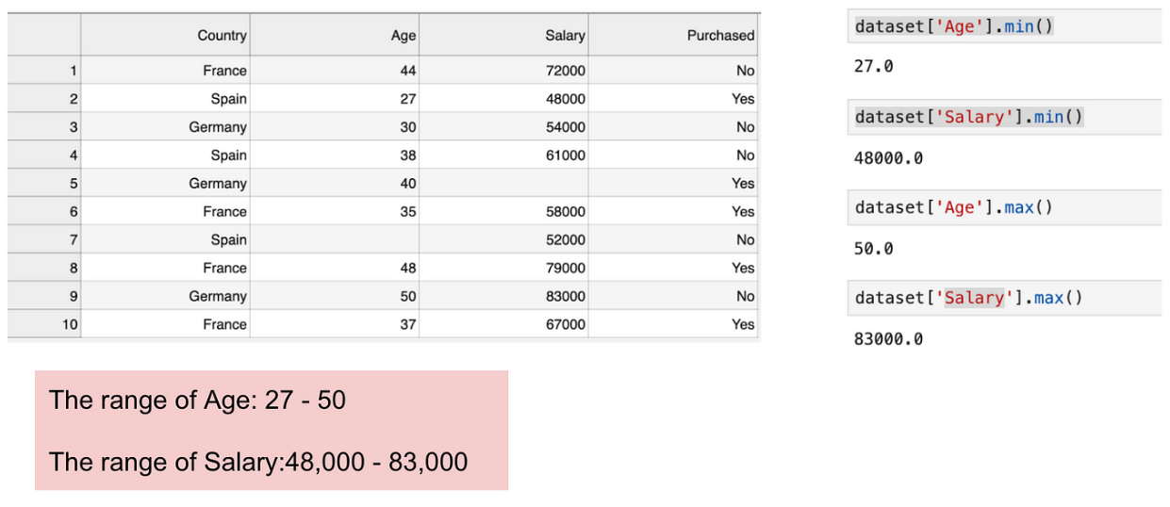
Data Transformation

Slide 6
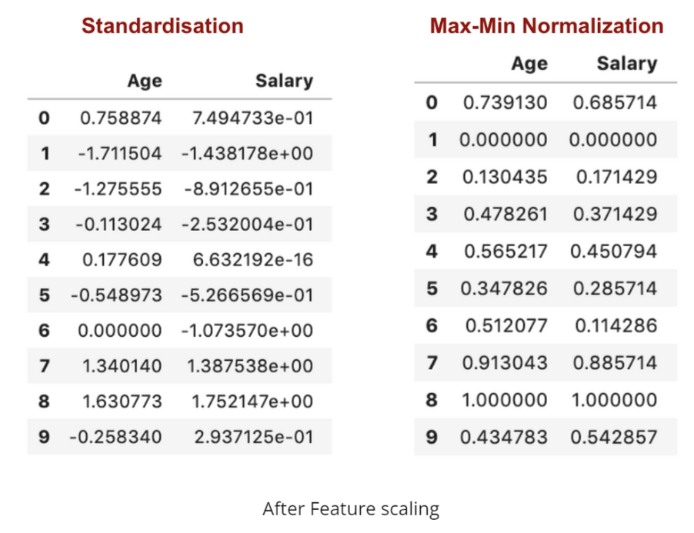
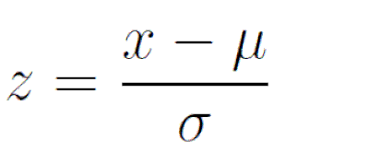

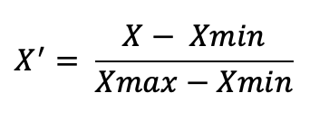
Data Transformation
Normalization Techniques:
- Standardisation/ Z-score normalization
- Min max Normalization

Slide 7
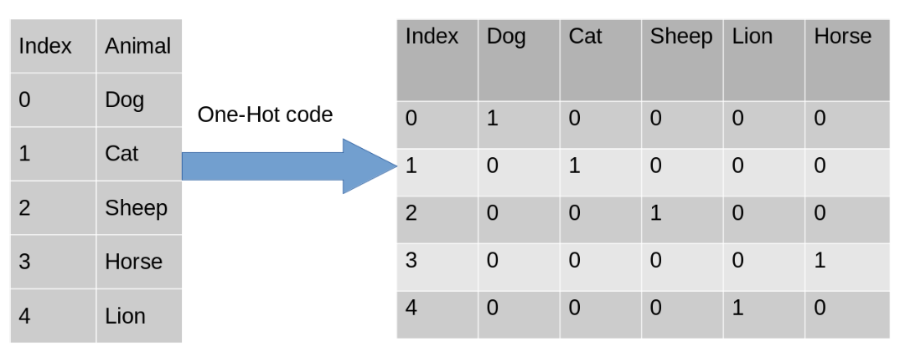
Data Transformation
Encoding Techniques:
1. One Hot Encoding

Slide 8
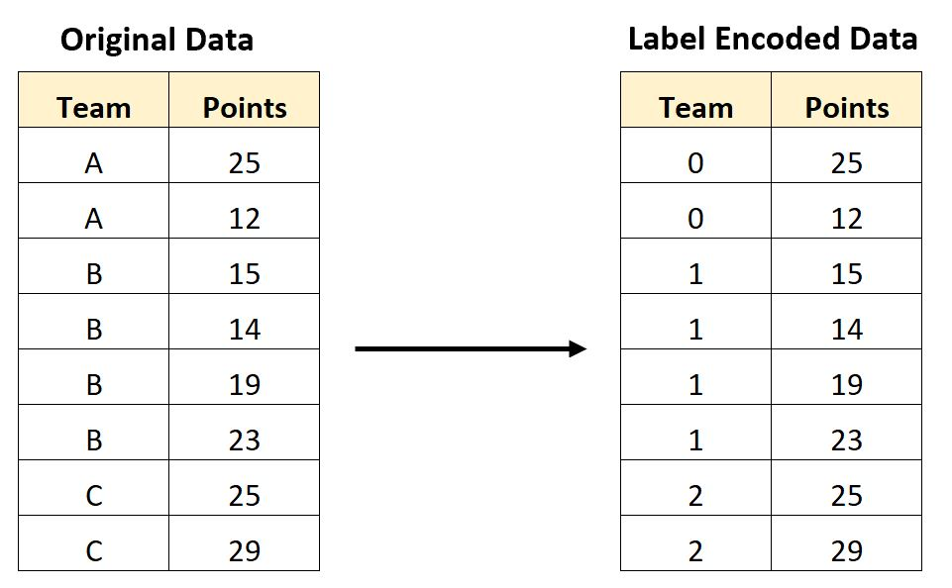
Data Transformation
Encoding Techniques:
2. Label Encoding/ Ordinal Encoding

Slide 9
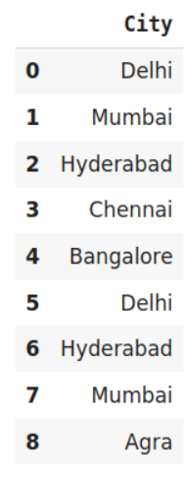
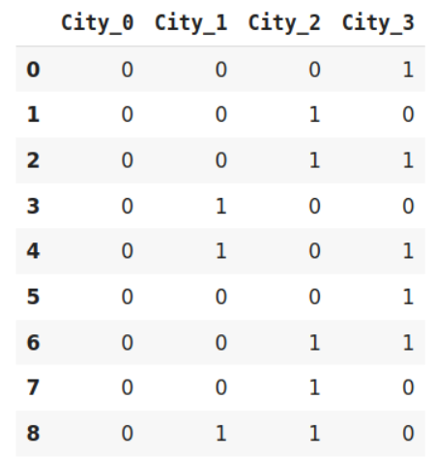
Data Transformation
Encoding Techniques:
3. Binary Encoding

Slide 10
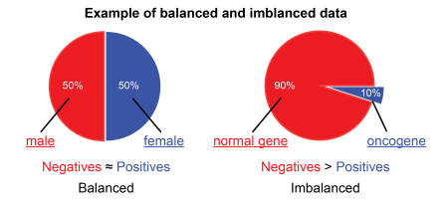
Data Imbalance

Slide 11
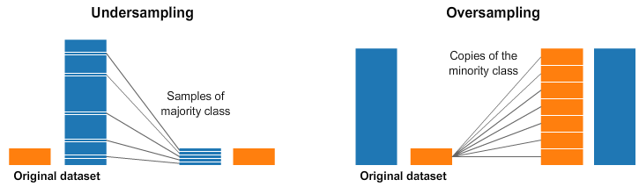
Data Imbalance
Two Ways of Handling Imbalanced Data

Slide 12
QUIZ

Slide 13
Question: Which imputation method is not ideal for data with outliers?
Answer: Mean Imputation

Slide 14
Question: Which imputation method is ideal for handling missing categorical values?
Answer: Mode

Slide 15
Question: Should we remove outliers from data?
Answer: Not always

Slide 16
Question: When are outliers important in data?
Answer: Fraud Detection, Spam Detection etc.

Slide 17
Question: When is deletion a bad choice for handling missing values?
Answer: If there are many records with missing values.

Slide 18
Question: When is one hot encoding not a good choice of encoding?
Answer: When there are huge number of classes.

Slide 19
Question: Can binary encoding be longer than one hot encoding?
Answer: No

Slide 20
Question: Is feature scaling done before or after imputation?
Answer: After

Slide 21
Question: Given the figure, where blue represents people who tested positive for cancer. Without handling imbalance, what would most likely be the outcome?
Answer: Normal

Slide 22
Question: Consider an imbalanced dataset of cancer test results, which would be more dangerous: 1) Majority records have positive results. 2) Majority records have negative results.
Answer: 2)

Slide 23
Thank You!

